Slide 1
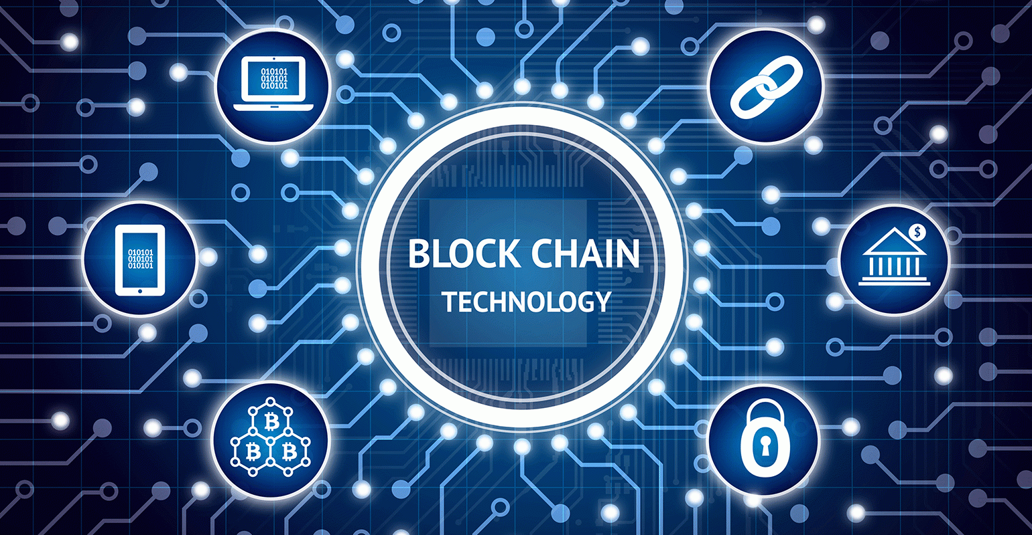

Slide 2
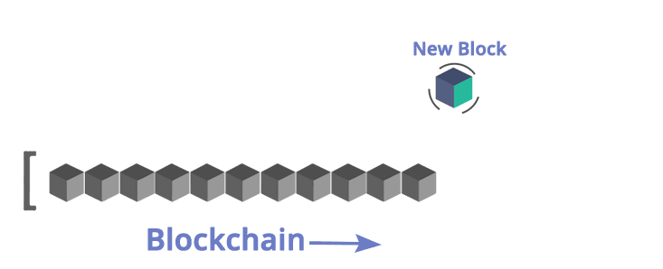
What is blockchain ?
A blockchain is a decentralized, public ledger where transactions are permanently recorded by appending blocks.
It is a continuously growing list of records.
Blocks are linked and secured using cryptographic techniques.
It is the technology behind the Bitcoins.

Slide 3
NEED FOR BLOCKCHAIN
Transaction Fees
Prone to Hacks
Centralized Power
Double Spending

Slide 4
3.Verification of Every Individual Transaction
Every single transaction is verified by cross-checking the ledger and the validation signal of the transaction is sent after a few minutes.
Through the usage of several complex encryption and hashing algorithm, the issue of double spending is eliminated.
2.Public Ledgers
The ledger which holds the details of all transactions which happen on the Blockchain, is open and completely accessible to everyone who is associated with the system.
Once you join the Blockchain network, then you can download the complete list of transaction since its initiation.
Even though the complete ledger is publicly accessible, the details of the people involved in the transactions remains completely anonymous.

Slide 5
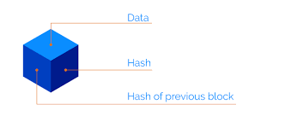
BLOCK
A block stores some or all of the recent transactions.
The average size of a block seems to be 1MB .
It is composed of a header and a long list of transactions.
The header contains metadata about a block.
  Version
  Hash of previous block
  Merkle root
  Timestamp
  Difficulty target
  Nonce

Slide 6
HASHING
It is the process by which a hash function takes a group of characters and converts it to a value of a certain length (called a hash value or hash).
The hash value is representative of the original string of characters, but is normally smaller than the original.
Even a small change in input will generate a completely different hash.
It is a one way process that means the final hash cannot be converted back into the original input.
Some hashing algorithms are MD5, SHA256, RIPEMD.

Slide 7
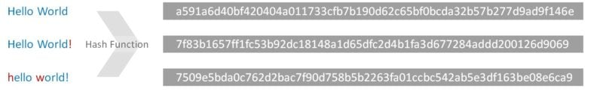
Sha256 hash function
The core hash alogorithm used in blockchain technology is the SHA256.
SHA-256 generates an almost-unique 256-bit (32-byte) signature for a text.
The purpose of using a hash is because the output is not ‘encryption’ i.e it cannot be decrypted back to the original text.
It is a ‘one-way’ cryptographic function, and is a fixed size for any size of source text.

Slide 8
Public key cryptography
This cryptographic technique helps the user by creating a set of keys referred as Public key and Private key.
Public key is shared with others whereas the Private key is kept as a secret by the user.
The data along with an encrypted digital signature is sent through the network for verification.
The Digital signature is again a hash value achieved by the combination of the user1 bitcoin address and the amount he is sending to user2.

Slide 9

P2P NETWORK
Every single person on the network has a copy of the ledger.
There is no single centralized copy.
Ledger is distributed across all users of Bitcoin Blockchain, i.e., the ledger has no central location where it is stored.
Everyone on the network owns a copy of the ledger and the true copy is the collection of all the distributed ledgers.
.

Slide 10
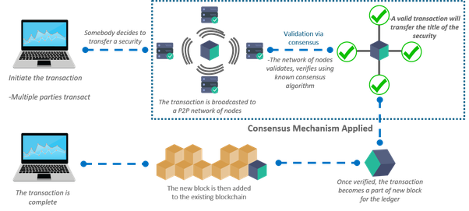

Slide 11

What is bitcoin ?
Bitcoin (BTC) is a digital currency, which is used and distributed electronically.
Bitcoin system is a decentralised peer-to-peer network. No single institution or person controls it.
The Bitcoin network is sharing a public ledger called the "block chain". This ledger contains every transaction ever processed. Digital records of transactions are combined into "blocks".
Unlike normal currencies, Bitcoins cannot be created as needed. Only 21 Million Bitcoins can be created, of which 17 million have already been created.

Slide 12
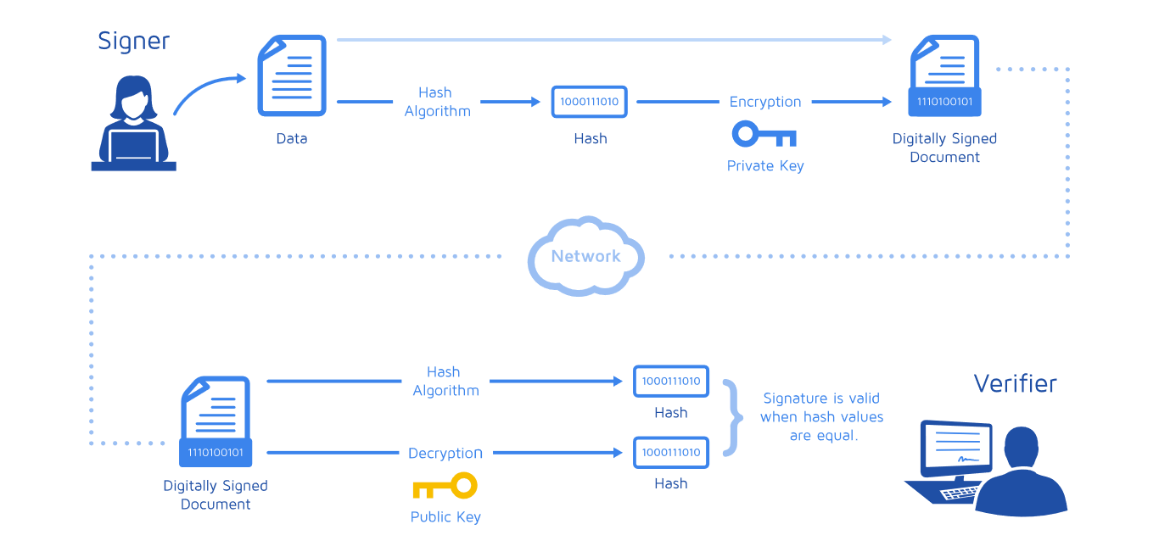
HOW DOES IT WORK ?

Slide 13
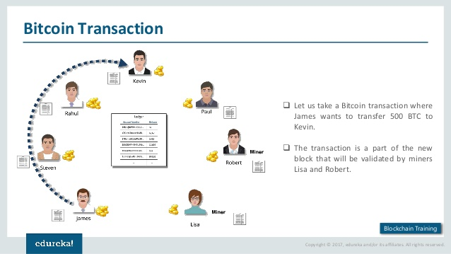

Slide 14
MINING
Bitcoin mining is the process by which transactions are verified and added to the public ledger, known as the block chain.
It is done by some special nodes called miners.
They solve a complex mathematical puzzle that is part of the bitcoin program, and including the answer in the block.
The aim is to find a number (nonce) that, when combined with the data in the block and passed through a hash function, produces a result that is within a certain range.
The resulting hash has to start with a pre-established number of zeroes.
The first miner to get a resulting hash within the desired range is authorised to add his block in blockchain.
As a reward for its work, the victorious miner gets 12.5 bitcoins.

Slide 15
TYPES OF BLOCKCHAINS
Public: Public blockchains have ledgers visible to everyone on the internet and anyone can verify and add a block of transactions to the blockchain.
Private: all permissions are kept centralized to an organization. Private blockchains allow only specific people in the organization to verify and add transaction blocks but everyone on the internet is generally allowed to view.
Consortium: controlled by a consortium of members. Only predefined set of nodes have access to write the data or block.

Slide 16
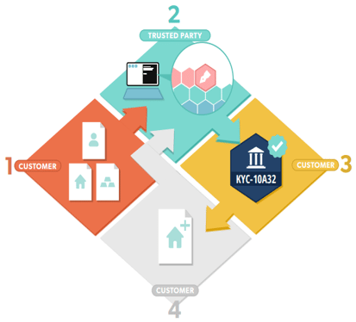
Future of Blockchain Technology
Blockchain technology can be used to remove the middle-men and centralized third parties that handle transactions in various industries. This may result in lost jobs in the future but the pros heavily outweigh the cons. Let’s take a look at a few industries that blockchain promises to drastically change.
The Entertainment Industry – With blockchain implemented in the entertainment industry, people could directly pay authors and artists without the need of record label or third party firm handling them. At this moment services like Spotify and Amazon take 95% of artist revenue.

Slide 17
International Payment – With blockchain, international payments by individuals and companies become cheap, fast, and secure. Blockchain technology can automatically ensure that money changes hands fairly, and since it removes the middle-men too transaction costs become cheaper too
Identity Verification and KYC – KYC has become a tedious job to do, as we have to do it a number of times for different parties whether it be your different banks and digital asset providers. With KYC on the blockchain, a person has to do KYC only once and can be assured that whenever his identity proof is needed it’s just a few touches away.

